Slide 1

Micro Credit Defaulter Project
Created By – Kshitij Chawla

Slide 2
Problem Statement
In order to improve the selection of customers for the credit, the client wants some predictions that could help them in further investment and improvement in selection of customers.
Build a model which can be used to predict in terms of a probability for each loan transaction, whether the customer will be paying back the loaned amount within 5 days of insurance of loan. In this case, Label ‘1’ indicates that the loan has been payed i.e. Non- defaulter, while, Label ‘0’ indicates that the loan has not been payed i.e. defaulter.

Slide 3
Conceptual Background of the Domain Problem
The project will require knowledge and practice in building Graphs /plots and analysing them to get the relationship between dataset, Knowledge of Different Learning Models to build and predict the required output. Basic Data science concepts to increase the quality of the dataset and Python Knowledge (Coding Language) which will be used to solve the complete Micro Credit Defaulter project. Understanding of calculating F2 score, accuracy, skewness and basic mathematics/statistical approaches will help to build an accurate model for this project.

Slide 4
Exploratory Data Analysis performed on the dataset
1) Checked the shape of the dataset : We have 209593 rows and 37 columns in our dataset
2) Checked the datatypes of the columns:
pcircle, pdate, msisdn are of type object which will be required to be converted or removed while training the model
3) There are 0 null values and repeated rows in the dataset
4) The Target variable ‘label’ is Highly Unbalanced which will be required to be balanced before the model building
5) Outliers are present in 'aon', 'daily_decr30', 'daily_decr90',
'rental30', 'rental90', 'last_rech_date_ma', 'last_rech_date_da',
'last_rech_amt_ma', 'cnt_ma_rech30', 'fr_ma_rech30',
'sumamnt_ma_rech30

Slide 5
Exploratory Data Analysis performed on the dataset
', 'medianamnt_ma_rech30', 'medianmarechprebal30',
'cnt_ma_rech90', 'fr_ma_rech90', 'sumamnt_ma_rech90',
'medianamnt_ma_rech90', 'medianmarechprebal90', 'cnt_da_rech30',
'fr_da_rech30', 'cnt_da_rech90', 'fr_da_rech90', 'cnt_loans30',
'amnt_loans30', 'maxamnt_loans30', 'medianamnt_loans30', 'cnt_loans90',
'amnt_loans90', 'maxamnt_loans90', 'medianamnt_loans90', 'payback30',
'payback90’ columns
Outliers are checked using BoxPlot method available in python library

Slide 6
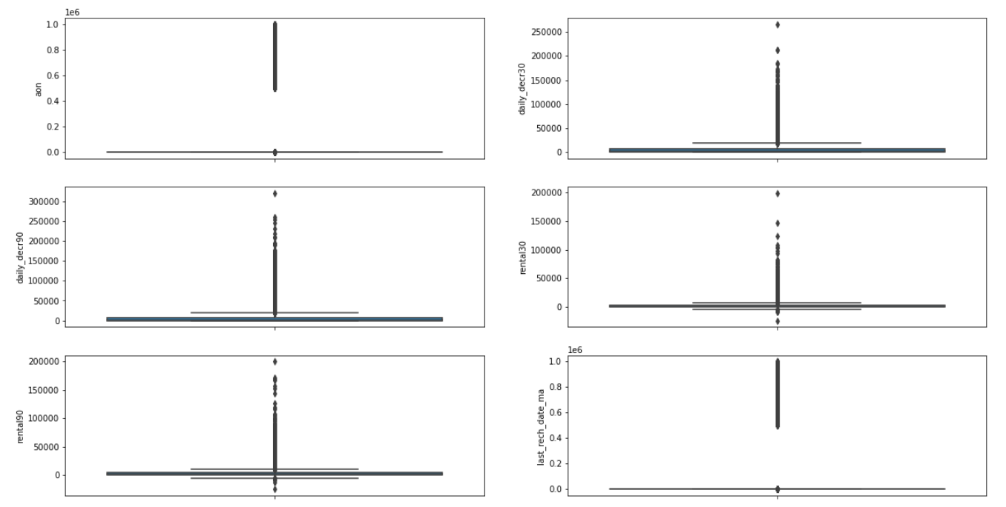
Exploratory Data Analysis performed on the dataset
Outliers Example from our dataset –

Slide 7
Exploratory Data Analysis performed on the dataset
6) Normal distribution of data:
Columns - last_rech_amt_ma, medianamnt_ma_rech_30, medianamnt_ma_rech90, cnt_da_rech_90, cnt_loans_30,amnt_loans_30
are not normally distributed
The data will be required to be normalized before building any model to increase the accuracy of the model
Normalization of the model is checked by plotting distance plot via libraries available in python

Slide 8
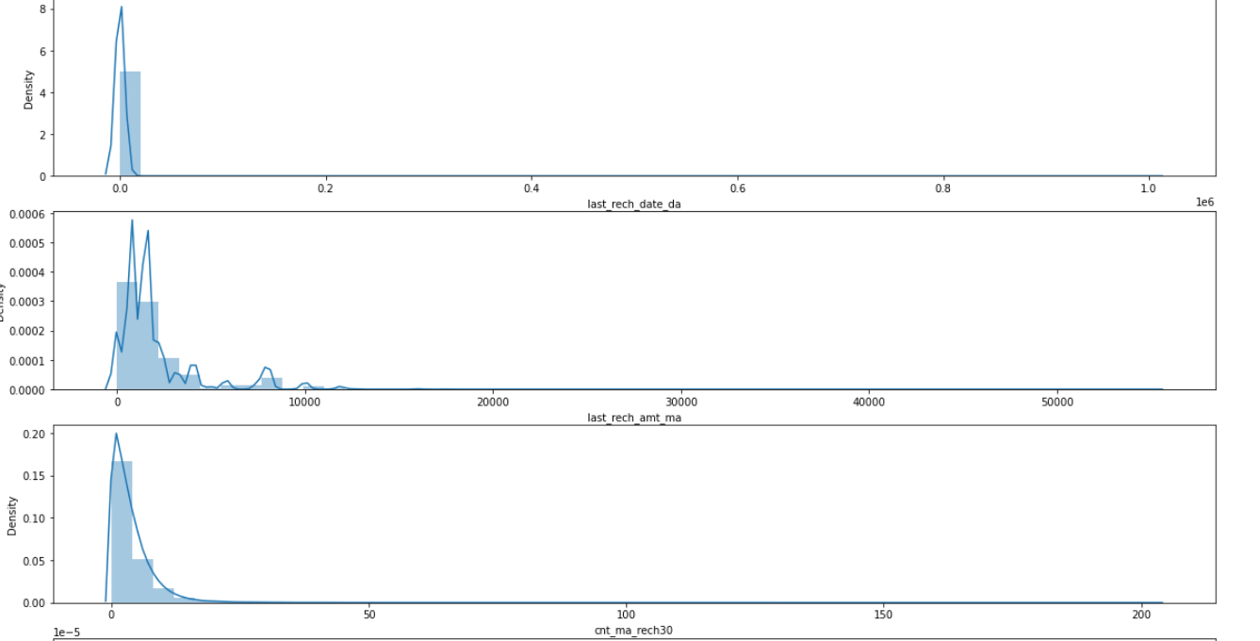
Exploratory Data Analysis performed on the dataset
Example of distplot from the dataset –

Slide 9
Exploratory Data Analysis performed on the dataset
7) Correlation between the variables:
amnt_loans30 is highly corelated with cnt_loans30
rental30 is highly correlated with rental 90
daily_decr30 is highly correlated with daily_decr90
Other columns are loosely correlated with each other.
We can find correlation using methods available in python library. And visualize the correlation using HeatMap.

Slide 10
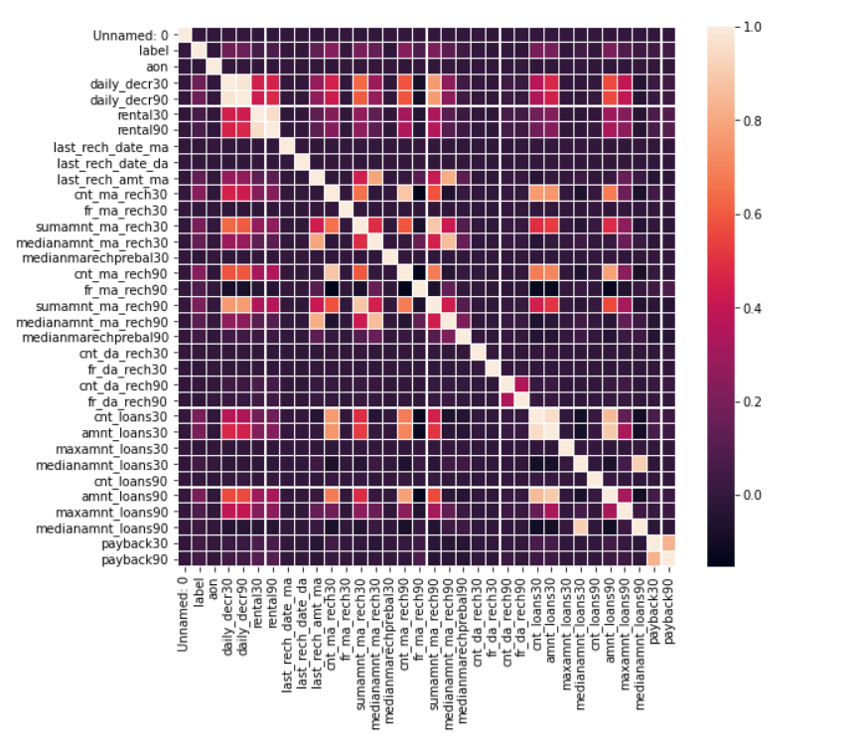
Exploratory Data Analysis performed on the dataset
Correlation Visualization in our dataset:

Slide 11
Exploratory Data Analysis performed on the dataset
7) Dataset was highly skewed, Before training the model skewness is required to be removed.
8) Removing Outliers: We replaced the outliers using IQR method. To increase the dataset quality. We confirmed the removal of outliers by plotting BoxPlot for the dataset
Code Logic Snippet:
IQR = df[col].quantile(0.75)-df[col].quantile(0.25)
Barmax = df[col].quantile(0.75) + 1.5*IQR
Barmin = df[col].quantile(0.25) - 1.5*IQR
df.loc[df[col]>Barmax,col] = Barmax
df.loc[df[col]<Barmin,col] = Barmin

Slide 12
Scaling the data
We Scaled the data using MinMaxScaler methodology
Code Logic Snippet
fin_df = df.drop(["label","msisdn","pcircle","pdate"],axis=1) #dropping the object type variables
scaler = preprocessing.MinMaxScaler()
minmax_df = scaler.fit_transform(fin_df)
final_df = pd.DataFrame(minmax_df, columns = fin_df.columns)

Slide 13
Removing Skewness
We tried different methods to remove skewness -> Log method, Sqrt method, Power Method,
Power Method removed the skewness perfectly.
Code Snippet:
fin_df_new=power_transform(final_df)
fin_df_new = pd.DataFrame(fin_df_new,columns=final_df.columns)

Slide 14
Converting Date Data type
Pdate attribute contains dates in object format. To build the model this was required to be converted into int/float attributes. Hence created 3 different attributes to replace pdate efficiecntly.(pday, pmonth,pyear)
Code Snippet:
df['pdate']=pd.to_datetime(df['pdate'],format="%Y-%m-%d")
date_df = pd.DataFrame({"p_year": df['pdate'].dt.year,"p_month": df['pdate'].dt.month,"p_day": df['pdate'].dt.day})

Slide 15
Train Test Split
We split the data into training and testing categories with 7:3 ratio.
We used inbuilt function in the model_selection library of python
Code snippet:
x_train,x_test,y_train,y_test = train_test_split(x,y,test_size=.30,random_state=5)

Slide 16
SMOTE to remove unbalanced target data
To remove the unbalanced issue in out target dataset we used SMOTE technique to fill the gap with dummy data.
Code snippet:
sm = SMOTE(random_state = 2)
x_train_res, y_train_res = sm.fit_resample(x_train, y_train.ravel())
print('After OverSampling, the shape of train_X: {}'.format(x_train_res.shape))
print('After OverSampling, the shape of train_y: {} \n'.format(y_train_res.shape))
print("After OverSampling, counts of label '1': {}".format(sum(y_train_res == 1)))
print("After OverSampling, counts of label '0': {}".format(sum(y_train_res == 0)))

Slide 17
Model training
We used different Models and compared the accuracy of the models:
Logistic Regression
Decision Tree
Support Vector Machine
Naïve Bayes
Random Forest

Slide 18
Model Training
Model Name | Accuracy
Logistic Regression | 76%
Decision Tree | 87%
Support Vector Machine | 84%
Naïve Bayes | 72%
Random Forest | 91%

Slide 19
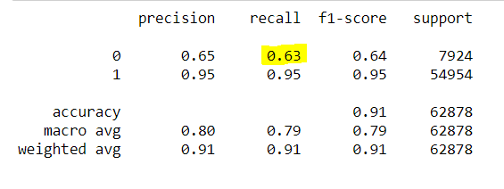
Model Training
After Cross Validation the best fit model is RandomForestClassifier Model with 91% accuracy
After performing Hyper-tuning of the model ->
The recall of 0 has been increased to 0.63 for the RandomForest

Slide 20
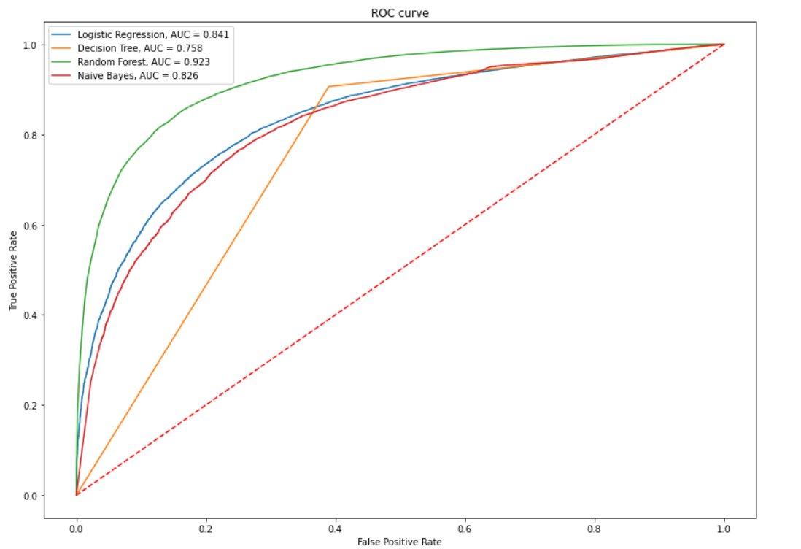
Model Training
ROC Curve for all the models:
As we can see from the Plot
Decision Tree model is
performing best as compared
To other algorithms

Slide 21
Thank you

